Slide 1
Chapter 0 – Prologue
Parth Nagarkar
* Content borrowed from: S. Dasgupta, C. H. Papadimitriou, and U. V. Vazirani. Algorithms

Slide 2
Prologue
Why are efficient algorithms so important today?
Al Khwarizmi wrote a textbook about basic methods for adding, multiplying, and dividing numbers
Al Khwarizmi → Algoritmi → Algorithms

Slide 3
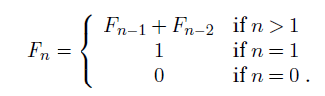
Fibonacci Sequence
Sequence of numbers:
0, 1, 1, 2, 3, 5, 8, 13, 21, 34, ….

Slide 4
Algorithm: Basic questions to answer
1) Is it correct?
2) How much time does it take, as a function of n?
3) And can we do better?

Slide 5
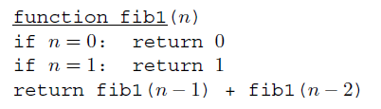
Fibonacci Algorithm 1
How much time does this algorithm take?
Let us denote the number of computer steps needed to solve an algorithm as T(n)

Slide 6
Fibonacci Algorithm 1
T(n) = T(n-1) + T(n-2) + 3 for n > 1
T(n) is exponential in n
Which implies that the algorithm is impractically slow (even with Moore’s law)

Slide 7
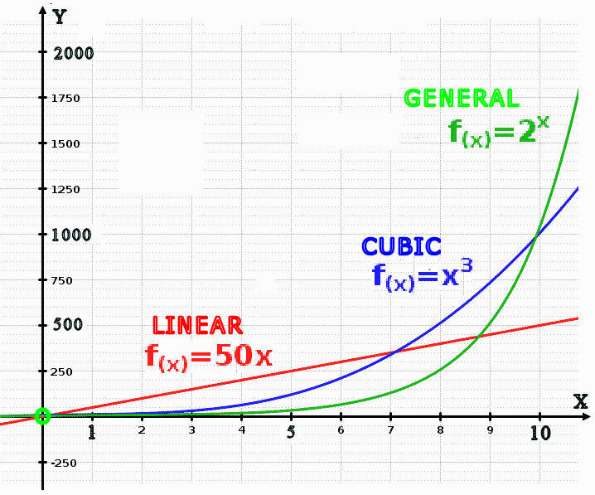
Exponential vs Linear
Image borrowed from: https://upload.wikimedia.org/wikipedia/commons/d/d9/Linear_Cubic_Exp_X.png

Slide 8
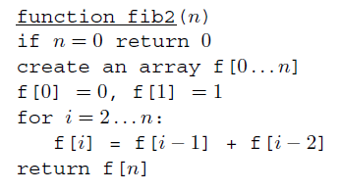
Fibonacci Algorithm 2
T(n) is linear in n

Slide 9
Big-O Notation
Expressing running time in terms of basic computer steps is quite a simplification
What are the disadvantages of being more precise?
Accounting for architecture-specific details is an extremely complicated task and does not generalize from one computer to the next

Slide 10
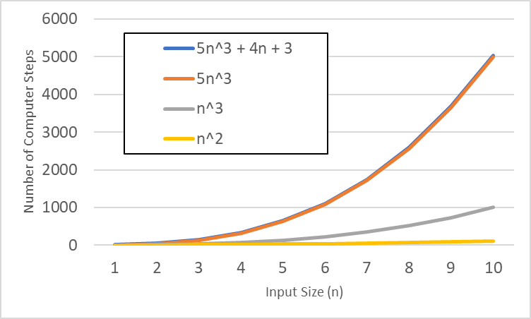
Big-O Notation
If an algorithm takes 5n³ + 4n + 3 steps for an input of size n, we say that the algorithm takes time O(n³)

Slide 11
Big-O Notation
Commonsense rules:
Multiplicative constants can be omitted
14n² becomes n²
nª dominates n^{b} if a > b
n² dominates n
Any exponential dominates any polynomial
3^{n} dominates n⁵
Any polynomial dominates any logarithm
n dominates (log n)³

Slide 12
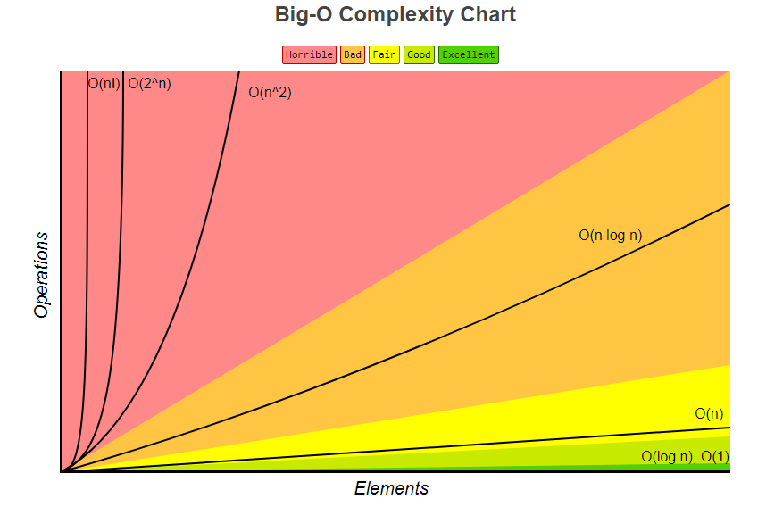
Big-O Notation
Image borrowed from: https://www.bigocheatsheet.com/

Slide 13
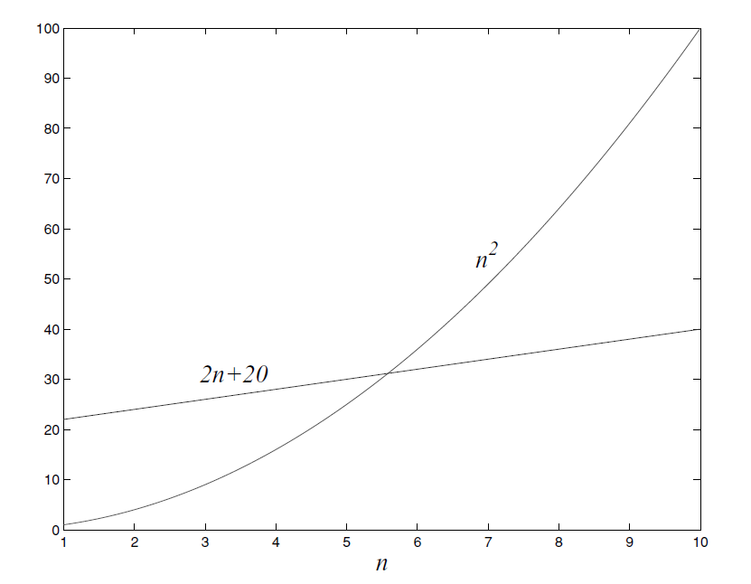
Big-O Notation
Which one is better?

Slide 14
Big-O Notation
Don’t misunderstand the attitude towards constants
Sometimes it is worth spending days improving an algorithm by a factor of 2

Slide 15
Big-O Notation
f(n) and g(n) are running times of two algorithms of inputs of size n
We say that f = O(g) (i.e. “f grows no faster than g”) if there is a constant c>0 such that f(n) ≤ c. g(n)
Saying f = O(g) is a very loose analog of “f ≤ g”

Slide 16

Big-O Notation
$$1<\log{n<\sqrt{n}<n<n\log{n<}n^{2}<n^{3}< ….<2^{n}<n!<n^{n}}$$
$f\left(n\right)=O(g\left(n\right))$ if $∃$ positive constants $c$ and $n_{0}$ such that $0≤f\left(n\right)≤cg\left(n\right) ∀n≥n_{0}$
$f\left(n\right)=2n+20$
$2n+20≤$

Slide 17
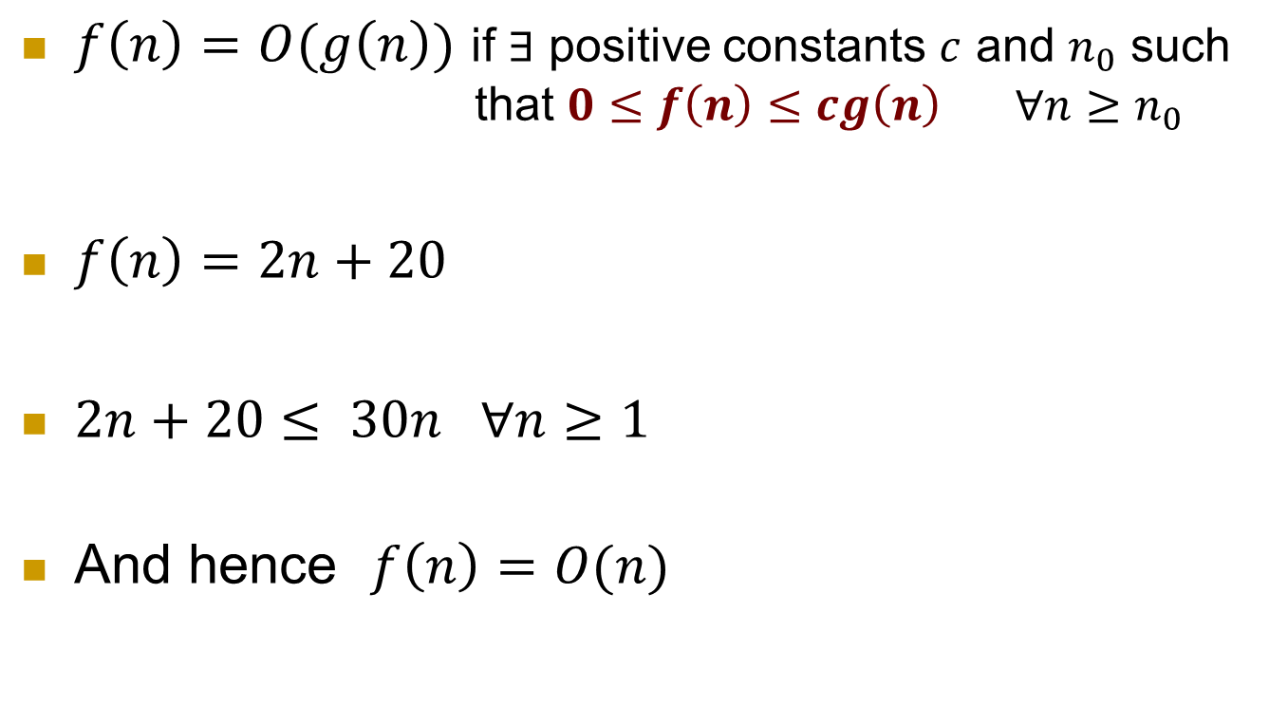
Big-O Notation
$$1<\log{n<\sqrt{n}<n<n\log{n<}n^{2}<n^{3}< ….<2^{n}<n!<n^{n}}$$
$f\left(n\right)=O(g\left(n\right))$ if $∃$ positive constants $c$ and $n_{0}$ such that $0≤f\left(n\right)≤cg\left(n\right) ∀n≥n_{0}$
$f\left(n\right)=2n+20$
$2n+20≤$ $30n ∀n≥1$
And hence $f\left(n\right)=O(n)$

Slide 18
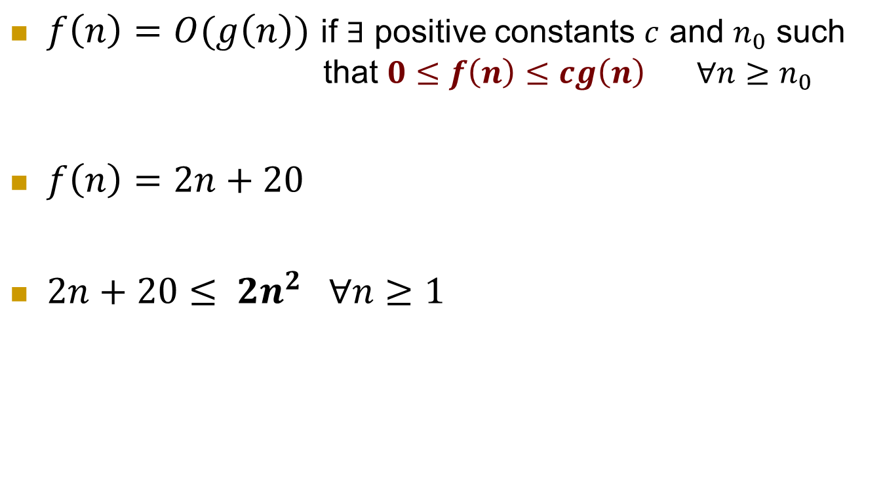
Big-O Notation
$$1<\log{n<\sqrt{n}<n<n\log{n<}n^{2}<n^{3}< ….<2^{n}<n!<n^{n}}$$
$f\left(n\right)=O(g\left(n\right))$ if $∃$ positive constants $c$ and $n_{0}$ such that $0≤f\left(n\right)≤cg\left(n\right) ∀n≥n_{0}$
$f\left(n\right)=2n+20$
$2n+20≤$ $2n^{2} ∀n≥1$

Slide 19
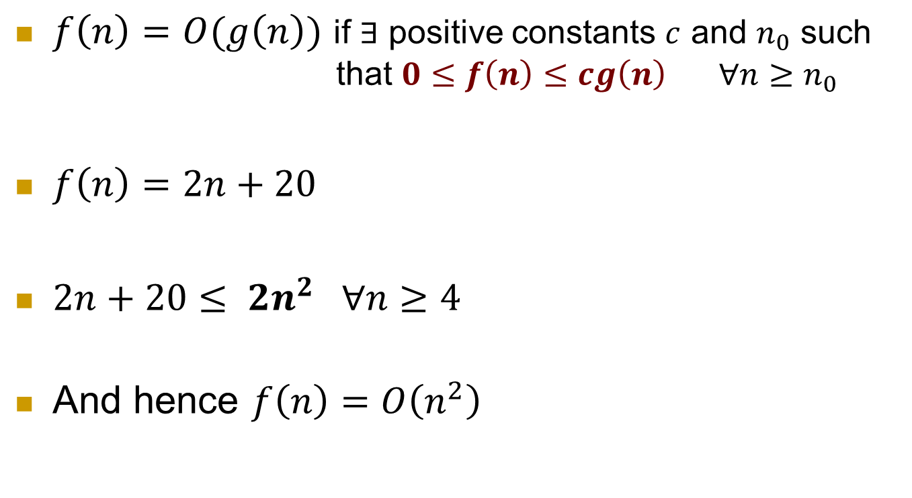
Big-O Notation
$$1<\log{n<\sqrt{n}<n<n\log{n<}n^{2}<n^{3}< ….<2^{n}<n!<n^{n}}$$
$f\left(n\right)=O(g\left(n\right))$ if $∃$ positive constants $c$ and $n_{0}$ such that $0≤f\left(n\right)≤cg\left(n\right) ∀n≥n_{0}$
$f\left(n\right)=2n+20$
$2n+20≤$ $2n^{2} ∀n≥4$
And hence $f\left(n\right)=O\left(n^{2}\right)$

Slide 20
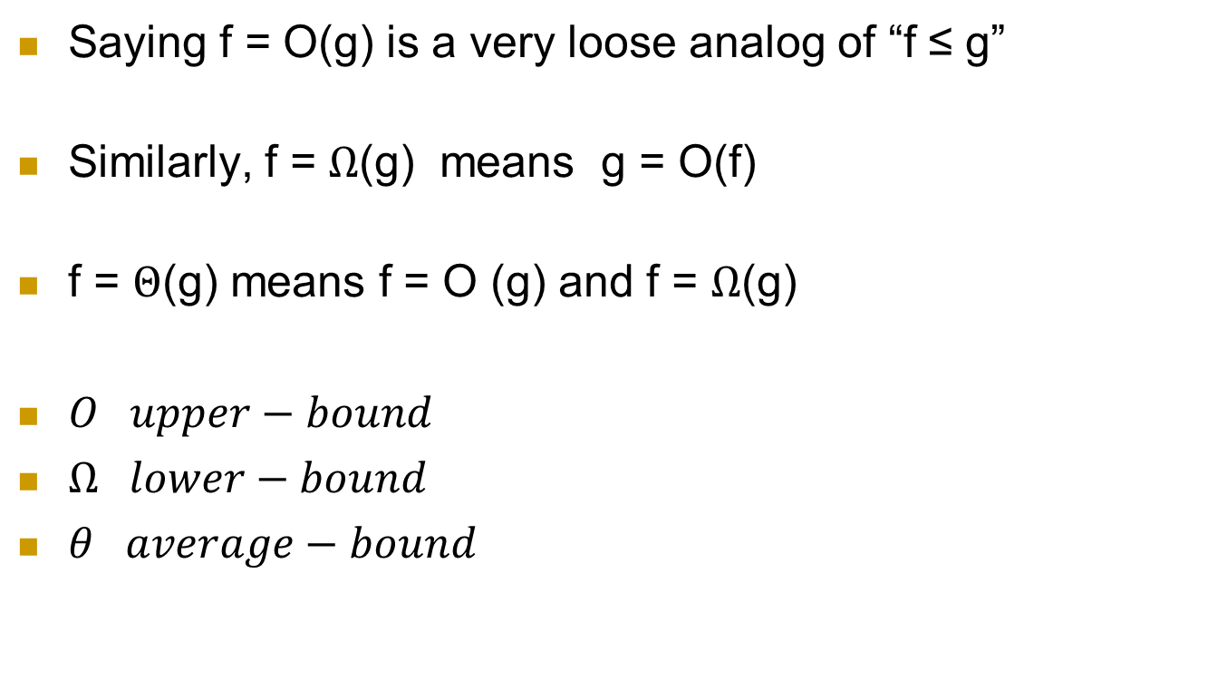
Big-O Notation
Saying f = O(g) is a very loose analog of “f ≤ g”
Similarly, f = $Ω$(g) means g = O(f)
f = $Θ$(g) means f = O (g) and f = $Ω$(g)
$O upper−bound$
$Ω lower−bound$
$θ average−bound$

Slide 21


Big-$Ω$ Notation
$$1<\log{n<\sqrt{n}<n<n\log{n<}n^{2}<n^{3}< ….<2^{n}<n!<n^{n}}$$
$f\left(n\right)=Ω(g\left(n\right))$ if $∃$ positive constants $c$ and $n_{0}$ such that $f\left(n\right)≥cg\left(n\right)≥0 ∀n≥n_{0}$
$f\left(n\right)=2n+20$
$2n+20≥$

Slide 22
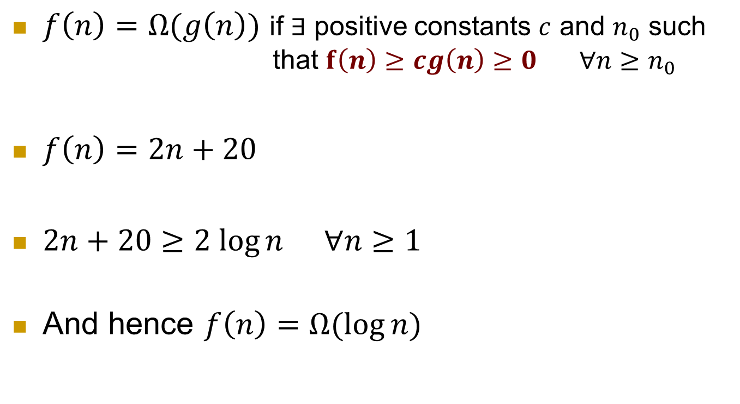
Big-$Ω$ Notation
$$1<\log{n<\sqrt{n}<n<n\log{n<}n^{2}<n^{3}< ….<2^{n}<n!<n^{n}}$$
$f\left(n\right)=Ω(g\left(n\right))$ if $∃$ positive constants $c$ and $n_{0}$ such that $f\left(n\right)≥cg\left(n\right)≥0 ∀n≥n_{0}$
$f\left(n\right)=2n+20$
$2n+20≥2 log{n} ∀n≥1$
And hence $f\left(n\right)=Ω(\log{n)}$

Slide 23
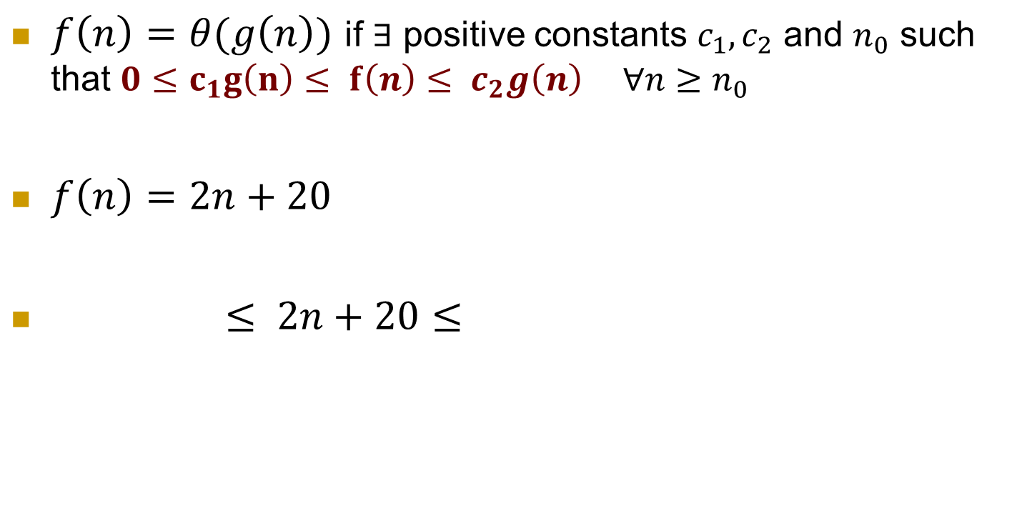
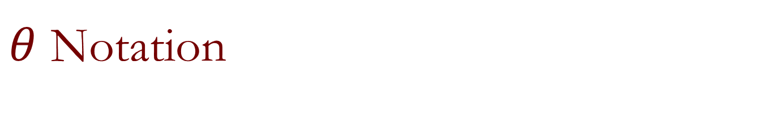
$θ$ Notation
$$1<\log{n<\sqrt{n}<n<n\log{n<}n^{2}<n^{3}< ….<2^{n}<n!<n^{n}}$$
$f\left(n\right)=θ(g\left(n\right))$ if $∃$ positive constants $c_{1},c_{2}$ and $n_{0}$ such that $0≤c_{1}g\left(n\right)≤ f\left(n\right)≤ c_{2}g\left(n\right) ∀n≥n_{0}$
$f\left(n\right)=2n+20$
$≤ 2n+20≤$

Slide 24
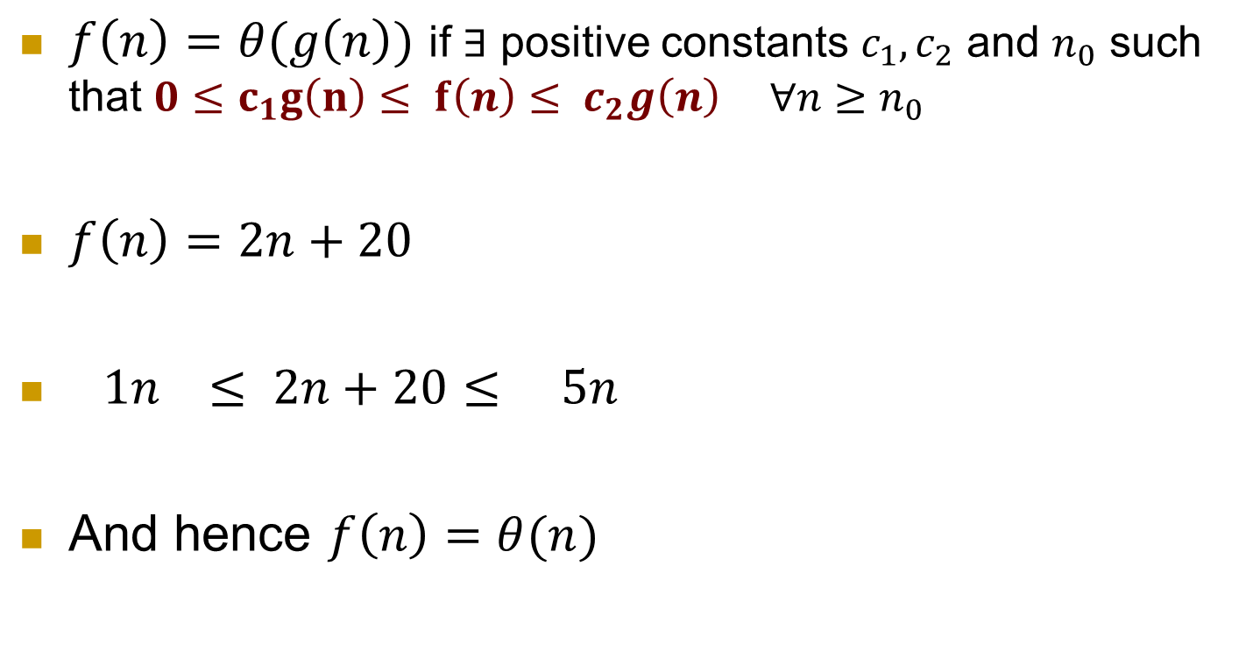
$θ$ Notation
$$1<\log{n<\sqrt{n}<n<n\log{n<}n^{2}<n^{3}< ….<2^{n}<n!<n^{n}}$$
$f\left(n\right)=θ(g\left(n\right))$ if $∃$ positive constants $c_{1},c_{2}$ and $n_{0}$ such that $0≤c_{1}g\left(n\right)≤ f\left(n\right)≤ c_{2}g\left(n\right) ∀n≥n_{0}$
$f\left(n\right)=2n+20$
$1n ≤ 2n+20≤ 5n$
And hence $f\left(n\right)=θ(n)$

Slide 25
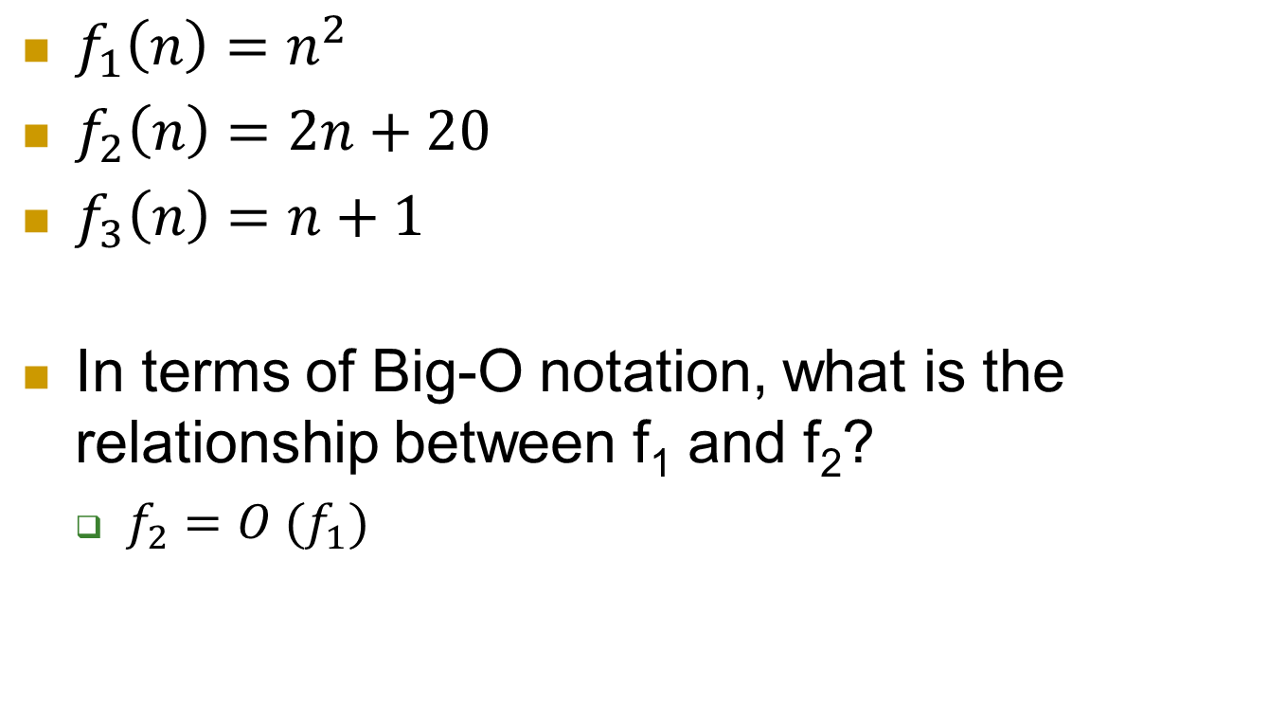
Big-O Notation
$f_{1}\left(n\right)=n^{2}$
$f_{2}\left(n\right)=2n+20$
$f_{3}\left(n\right)=n+1$
In terms of Big-O notation, what is the relationship between f₁ and f₂?
$f_{2}=O (f_{1})$

Slide 26
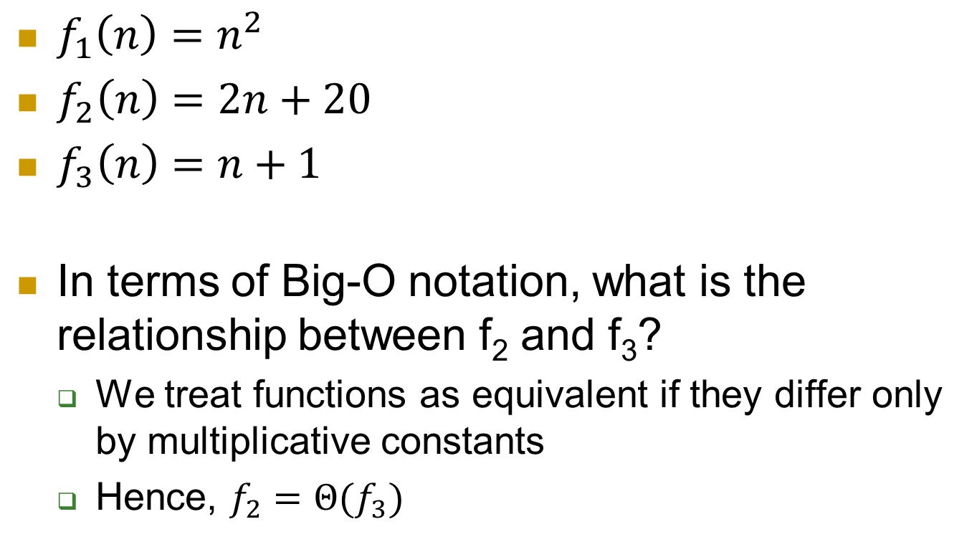
Big-O Notation
$f_{1}\left(n\right)=n^{2}$
$f_{2}\left(n\right)=2n+20$
$f_{3}\left(n\right)=n+1$
In terms of Big-O notation, what is the relationship between f₂ and f₃?
We treat functions as equivalent if they differ only by multiplicative constants
Hence, $f_{2}=Θ(f_{3})$

Slide 27

Big-O Notation
$f_{1}\left(n\right)=n^{2}$
$f_{2}\left(n\right)=2n+20$
$f_{3}\left(n\right)=n+1$
In terms of Big- $Ω$ notation, what is the relationship between f₁ and f₃?
$f_{1}=Ω(f_{3})$

Slide 28

Big-O Notation
In each of the following, indicate whether $f=O\left(g\right)$ or $f=Ω(g)$ or both (in which case $f=Θ(g)$)
f(n) g(n)
n – 100 n – 200
n^{1/2} n^{2/3}
log 2n log 3n
n^{1/2} 5 ^{log2n}
$√n$ (log n)³

Slide 29

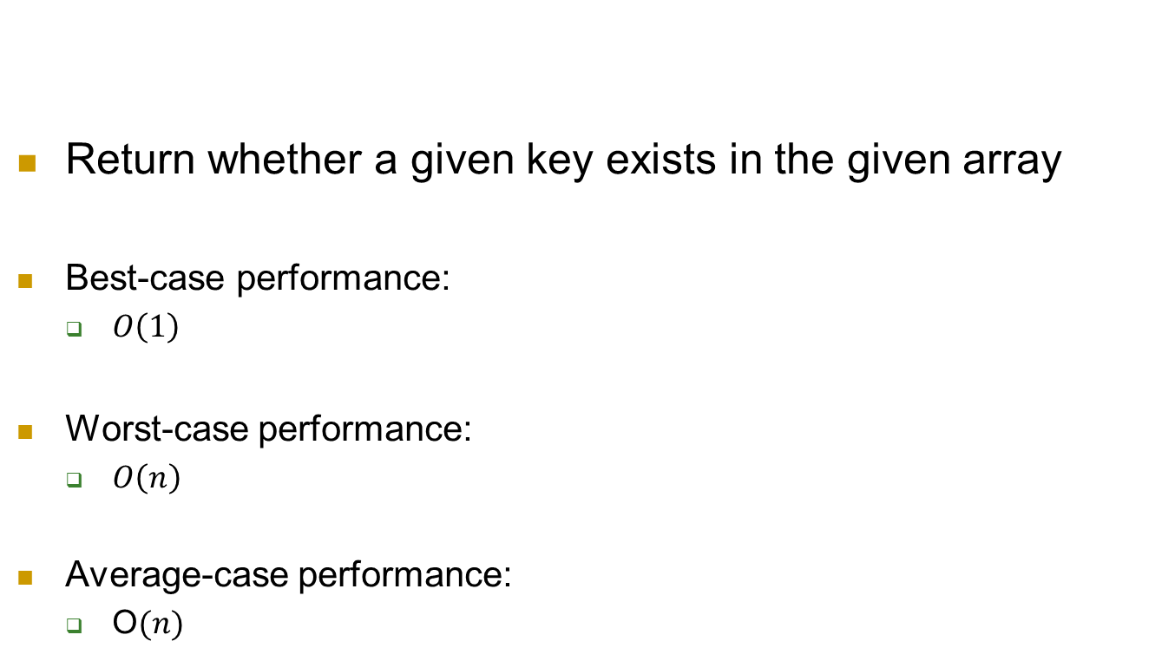
Average-case vs Best-case vs Worst-case Performance
Return whether a given key exists in the given array
Best-case performance:
$O\left(1\right)$
Worst-case performance:
$O\left(n\right)$
Average-case performance:
O$(n)$

Slide 30
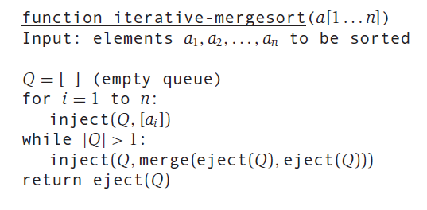
Iterative Mergesort

Slide 31
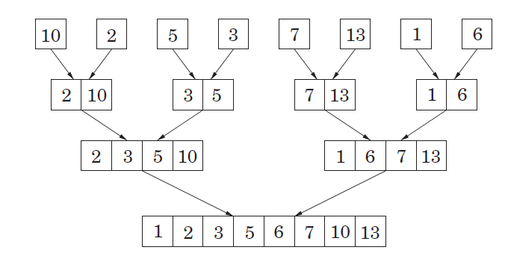
Iterative Mergesort

Slide 32
Iterative Mergesort

Slide 33
Iterative Mergesort

Slide 34
Iterative Mergesort

Slide 35
Iterative Mergesort

Slide 36

Iterative Mergesort
$$O(nlogn)$$

